Slide 1

Covid Death Rates Analysis
Travis Lindeman

Slide 2
Agenda
Stakeholder Interest
Data of Interest
EDA
Hypothesis Testing and Regression: Vaccination Rates vs Covid Deaths
Analysis of Ancillary Factors
Conclusion
Way Forward
Contact and Repository

Slide 3

Stakeholder interest
Gauge future pandemic response
Refine response to support vulnerable populations
Inform decision making by understanding at-risk societies

Slide 4
Dataset and cleaning
35 Columns, 302,000 Rows
By country data from 1/3/2020 to 4/12/2023
Missing values required using weekly averages in analysis
Likelihood of underreporting or overreporting not explicitly addressed
Overtime analysis uses weekly averages
Total analysis uses total or highest values to return unique values

Slide 5
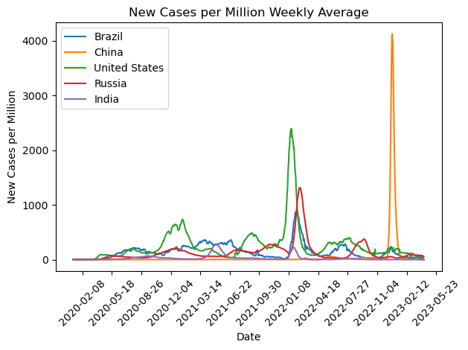
New cases over time
Correlates with China’s “reopening”
Seasonal spikes

Slide 6
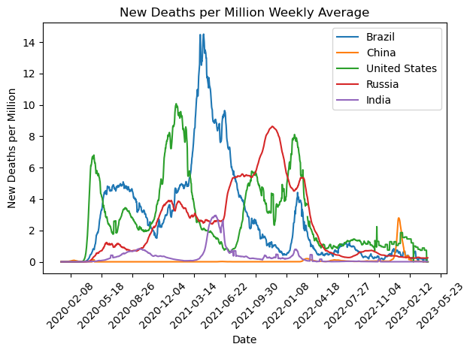
New deaths per million
Deaths Per Million makes Brazil look like the worst performer

Slide 7
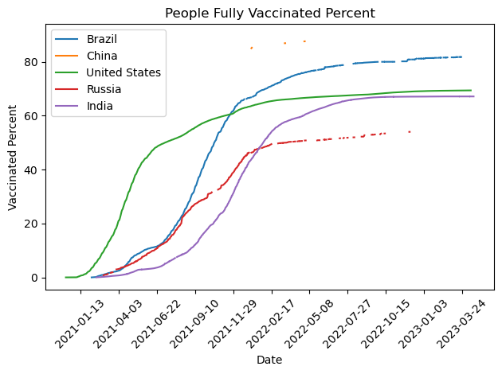
Population vaccination percentage
Inconsistent reporting may indicate data contamination or bias

Slide 8
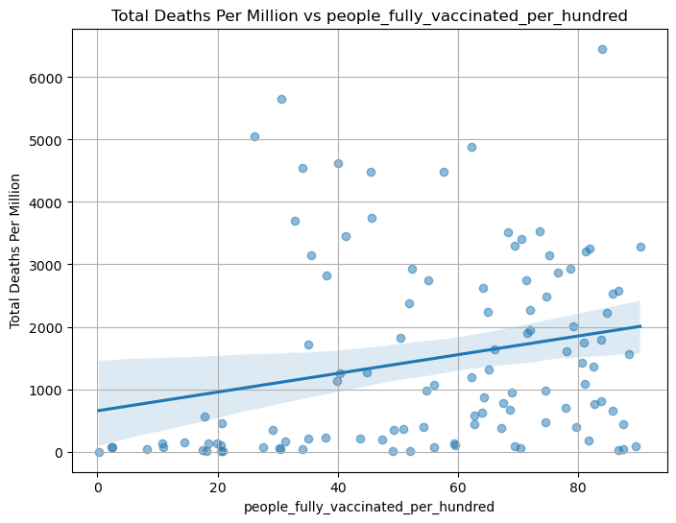
Hypothesis Test: Did vaccination rates decrease death rates?
Hypothesis:
H0: Vaccination rates do not lower the death rate in a country.
Hα: An increase in vaccination rates lowers the death rate in a country.
P-value: 0.002
Statistical results suggest accepting Hα within 95% confidence rating.
However, vaccination rates do not tell the entire story.

Slide 9
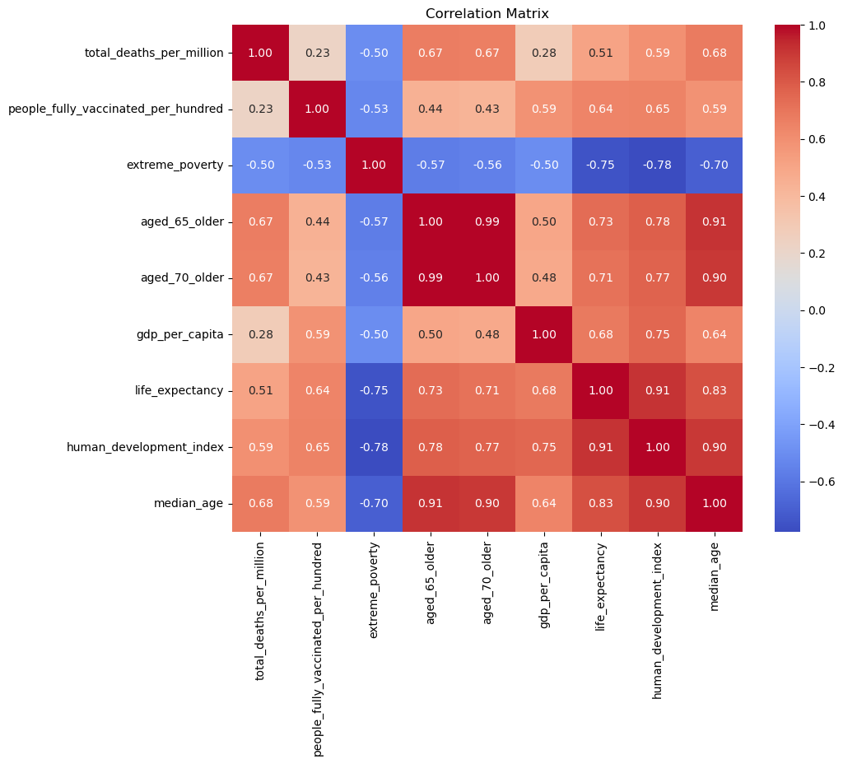
Additional factors affecting death rates
Total Deaths are negatively correlated with extreme poverty
Positively correlated with vaccination rates, increased age, wealthier nations, life expectancy, and human development

Slide 10
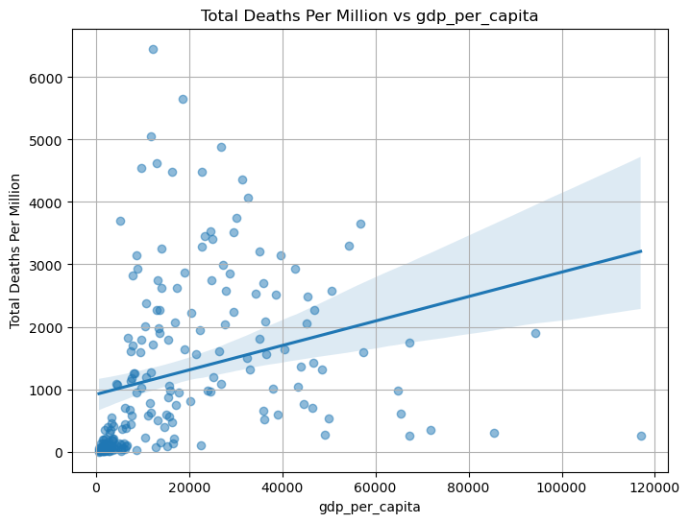
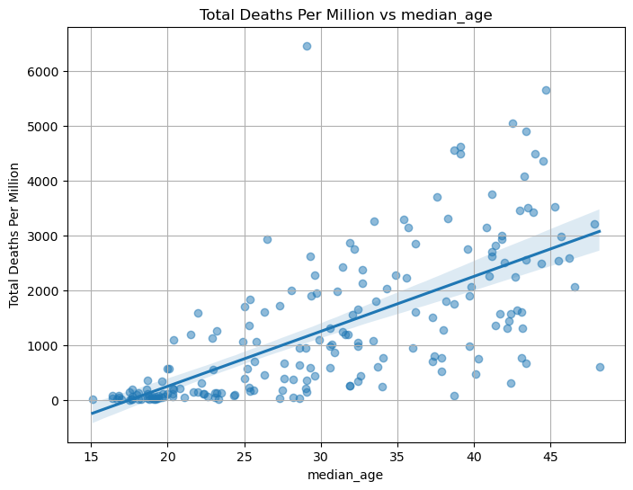
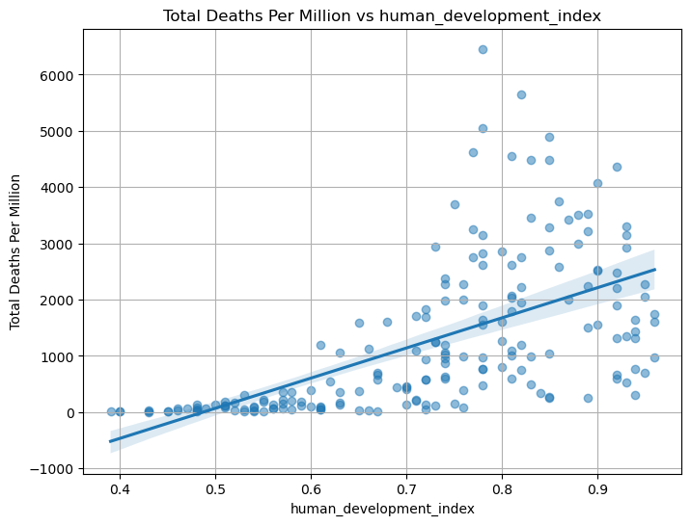
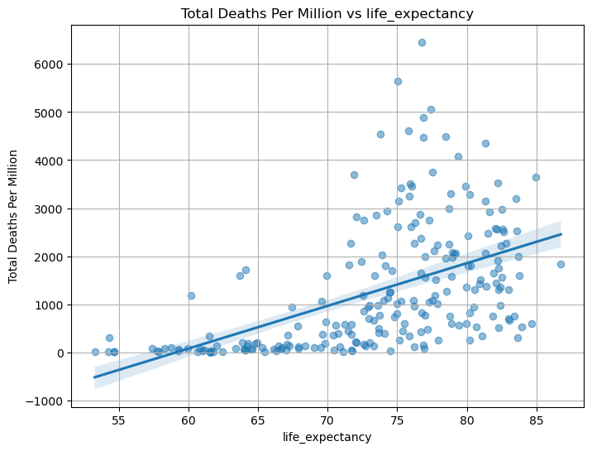
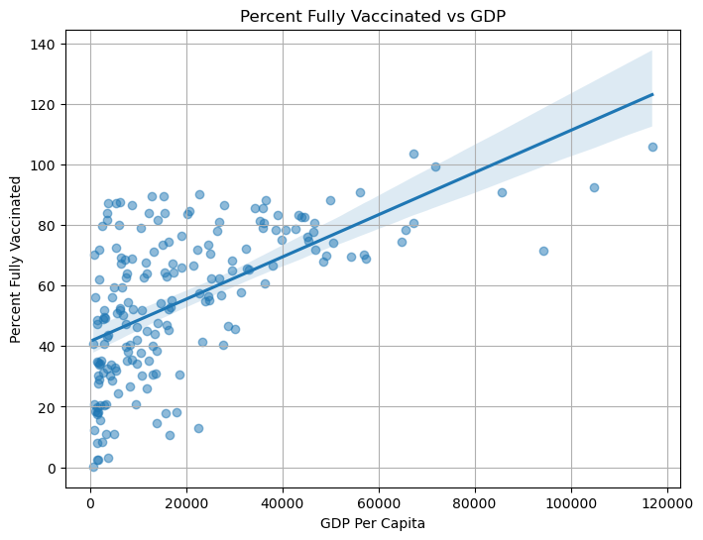
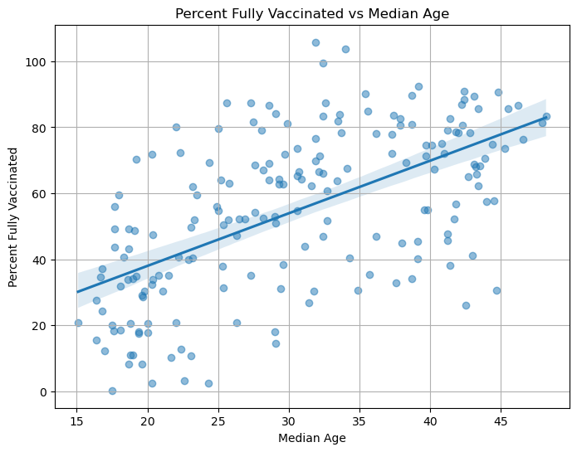
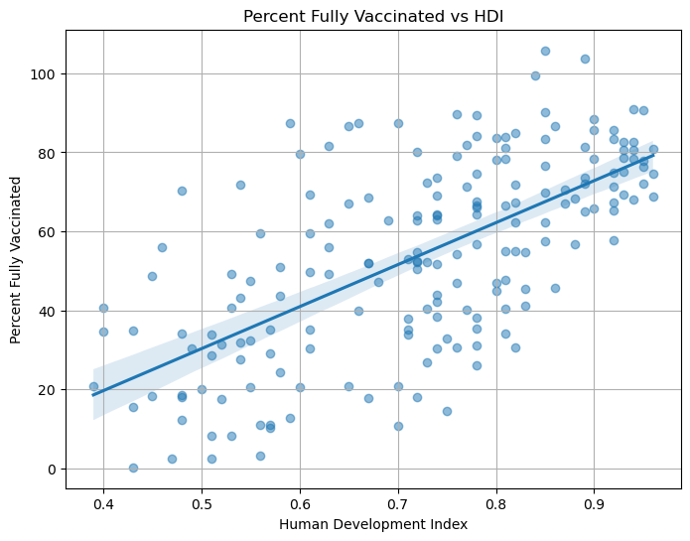
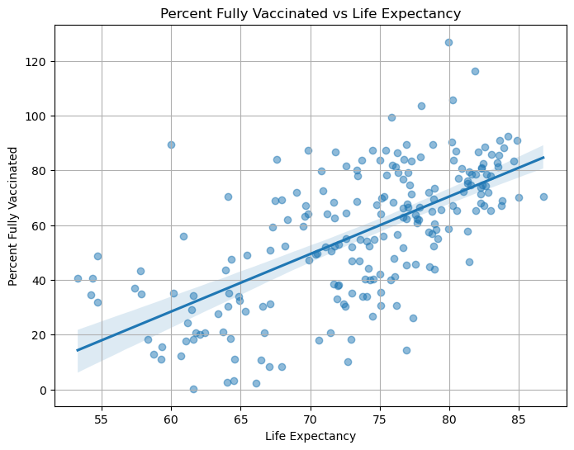
Multiple linear regression tests
gdp
Median age
hdi
Life expectancy
Total deaths
Vaccinated %

Slide 11
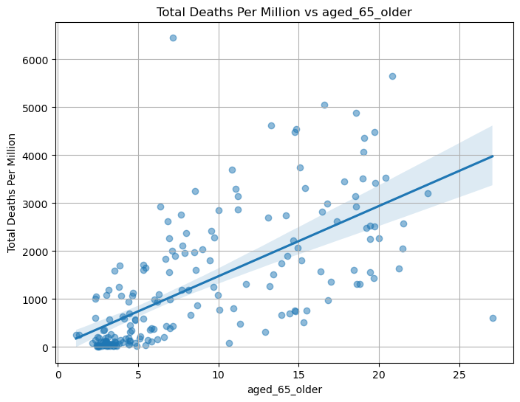
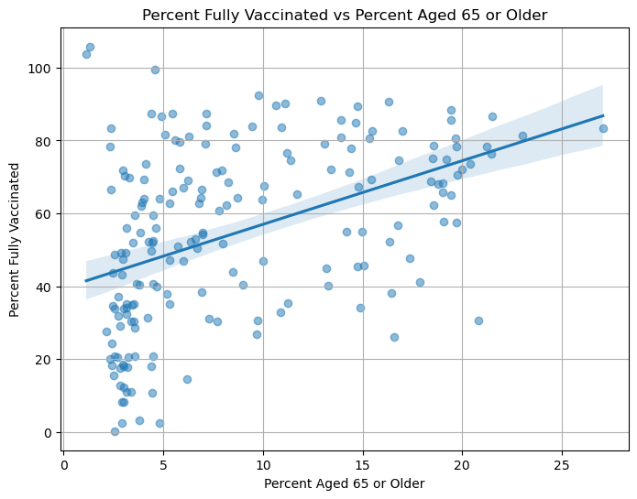
Multiple linear regression tests
gdp
hdi
Aged ≥ 65
Total deaths
Vaccinated %

Slide 12
conclusion
Efficacy of vaccinations statistically correlate with a decrease in total deaths, but this is not the only factor affecting death rates.
Covid vaccination rates correlate with wealthier, more developed, and older populations which died at higher rates than poorer and younger populations.
A country’s death rates from covid likely have more to do with the vulnerabilities of elderly populations.

Slide 13
Way forward
Assess pandemic intensity over time as opposed to total
Missing from this data is information about deaths by age group which could assist more refined assessments of vulnerable populations
Measuring by excess mortality improve accuracy and account for underreporting in poorer or autocratic countries

Slide 14
Contact and data links
Contact Info
Travis Lindeman
tralinde@gmail.com
Repository Link
https://github.com/tralinde/covid_data_project
Dataset Link
https://www.kaggle.com/datasets/tohidkhanbagani/covid-19-deaths-and-vaccinations-dataset

